Slide 1
Notes: Native Americans

Slide 2
Native Americans of North America
Divided into many Culture Areas
Culture Areas each have their own:
Language
Environment
Lifestyle

Slide 3
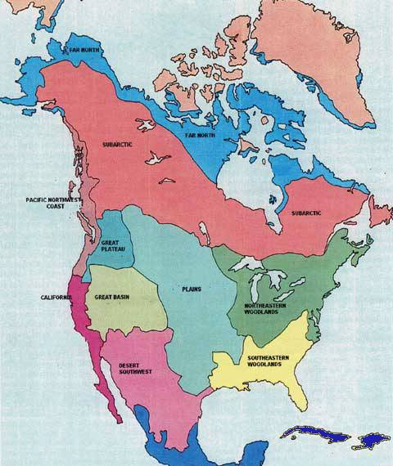
Map of Culture Areas of North America
http://nativeamericanrhymes.com/maps/na_regions.jpg

Slide 4
Pacific Coast Location
http://nativeamericanrhymes.com/maps/na_regions.jpg

Slide 5
Pacific Coast
Located in the Northwest on the Pacific ocean
Tribes: Tlingit, Nootka, and Skokomish
Hunted whales and sea otters in huge canoes
Built totem poles representing ancestors and animal spirits

Slide 6
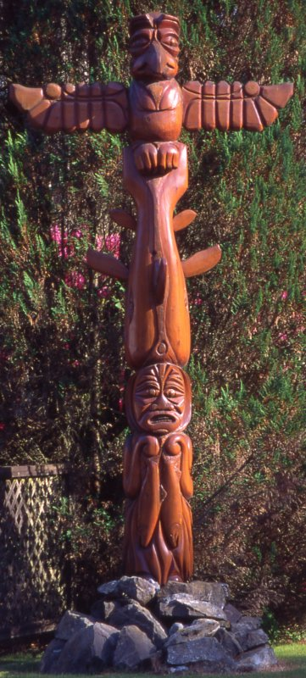
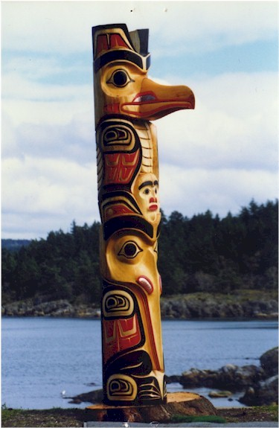
Totem Pole from the Pacific Coast
http://www.largecreations.com/totem.htm
http://www.georgestorry.com/images/totem3.jpg

Slide 7
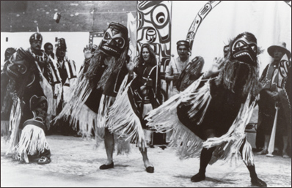
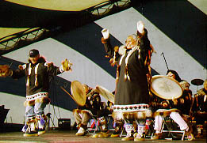
Potlatches- festival to show off one’s wealth and social standing (would give it all away)
http://www.yfnta.org/todo/todo.htm
http://www.haidadesigns.com/images/potlatch.jpg

Slide 8
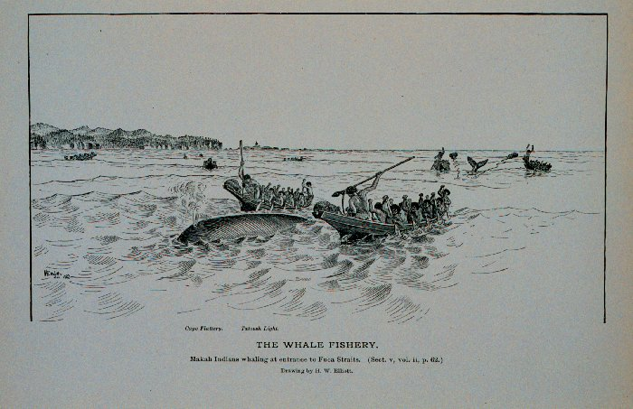
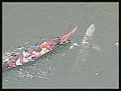
Whale Hunting
http://www.photolib.noaa.gov/historic/nmfs/figb0204.htm
http://www.kfrtkf.hu/egyseg/ID/CNN%20Stories/whalehunt/whalehunt.jpg

Slide 9
Southwest location
http://nativeamericanrhymes.com/maps/na_regions.jpg

Slide 10
Southwest
Location: Present day Arizona, New Mexico, and Mexico
Dry desert climate
Tribes: Apache, Navajo, and Pueblo
Pueblo- farmers, used irrigation
Apache-great hunters and gatherers, raided Pueblo villages

Slide 11
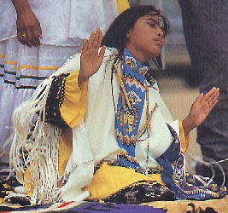
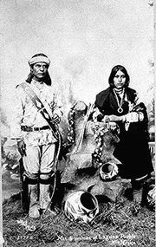
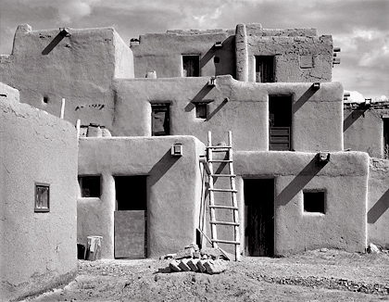
Southwest Native Americans
http://www.mythinglinks.org/ApacheGirl~pubertySite4.jpg
http://en.wikipedia.org/wiki/Pueblo_people
http://www.radekaphotography.com/taospueblo.htm

Slide 12
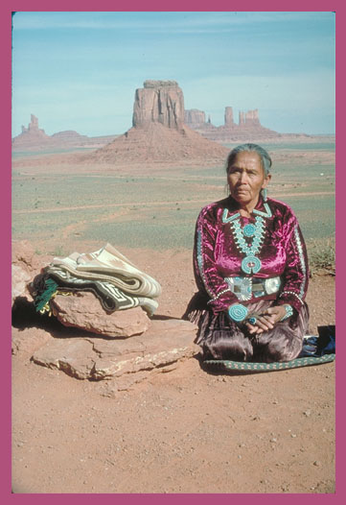
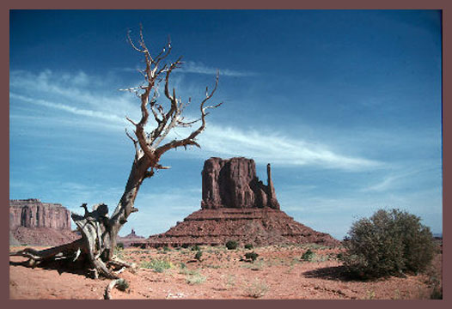
More Southwest pictures
http://www.westford.com/fingerhut/Southwest/Left-Mitton.jpg
http://www.westford.com/fingerhut/Southwest/Navajo-Woman.jpg

Slide 13
Location of Great Plains
http://nativeamericanrhymes.com/maps/na_regions.jpg

Slide 14
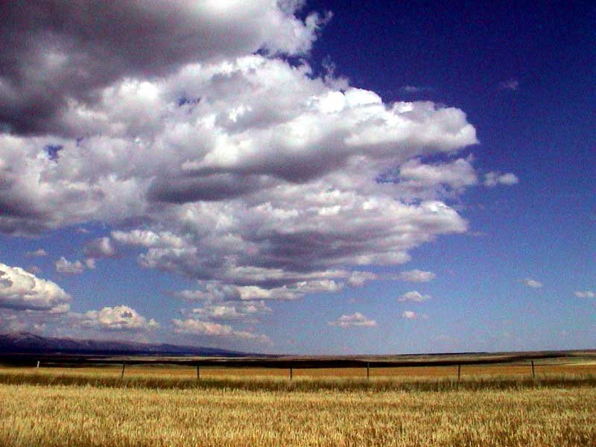
Great Plains
http://www.manishin.com/photos/best_photos/Images/great_plains.jpg

Slide 15
The Great Plains
Location: grasslands Between the Rocky Mountains and Mississippi River, Canada and Texas
Tribes: Sioux, Mandan, Pawnee, Comanche
Matrilineal: trace ancestry through mother rather than father
Grew beans, squash, and maize (corn)
Hunted Buffalo for clothing, food, shelter, tools

Slide 16
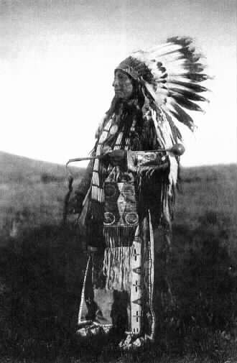
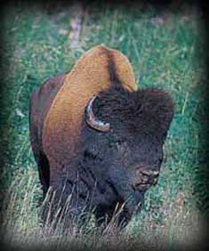
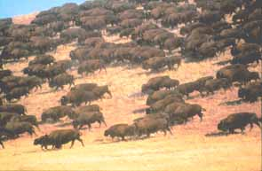
Great Plains
http://woglakapi.free.fr/sioux/images/tatanka.jpg
http://www.americanindians.com/sioux_1.jpg
http://www.harneypeak.com/images/BUFFALO.JPG

Slide 17
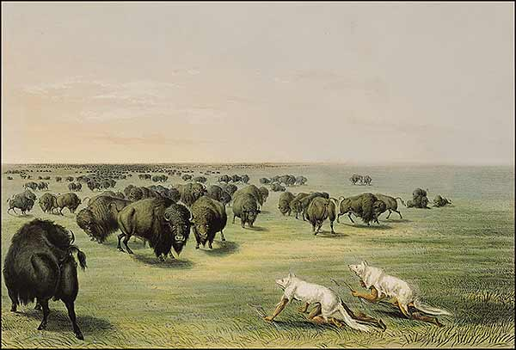
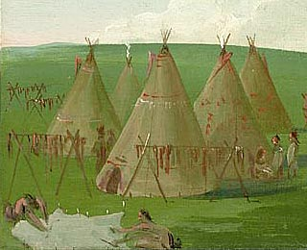
Great Plains
http://www.nebraskastudies.org/0300/media/0301_010902.jpg
http://www.cartermuseum.org/Inspiring_Visions/Catlin/catlin.html

Slide 18
Eastern Woodlands Location
http://nativeamericanrhymes.com/maps/na_regions.jpg

Slide 19
Eastern Woodlands
Location: East of the Mississippi river to the Atlantic Ocean
Mostly forests, includes the Appalachian Mountains and Great Lakes
Hunter gatherers in the forests, farmed and fished
Lived in permanent villages, usually by rivers
Tribes:
North: Algonquian, Iroquois, Mohawk
South: Cherokee, Creek, Seminole

Slide 20
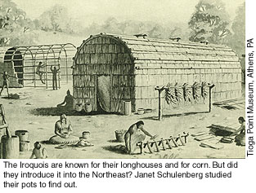
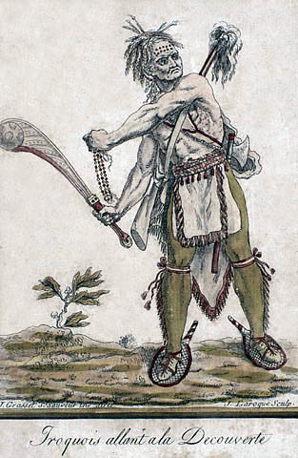
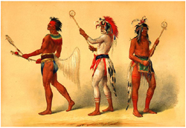
Eastern Woodlands (North)
http://www.rps.psu.edu/0101/graphics/Iroquois.jpg
http://www.hotcakencyclopedia.com/People/image.BallPlayers.catlin.jpeg
http://northernblue.ca/canata/1_beginnings/1images/1iroquois/IROQUOIS.JPG

Slide 21
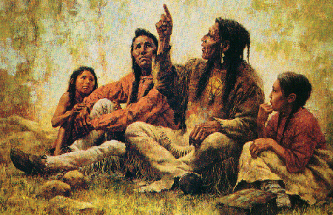
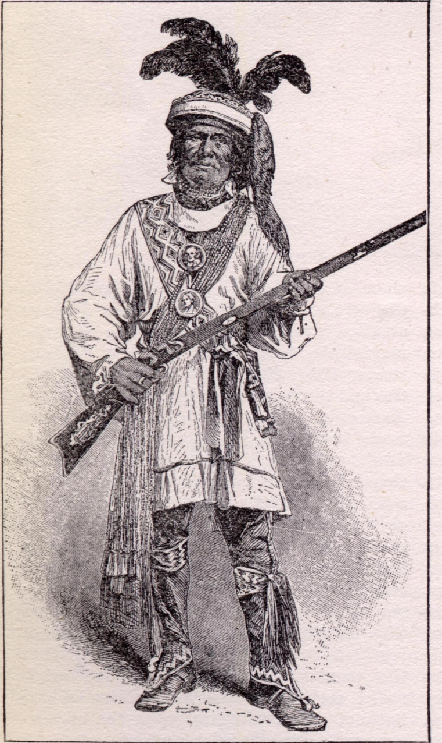
Eastern Woodlands in the south
http://garnet.acns.fsu.edu/~bjb03/six_files/Image16.gif
http://www.sonofthesouth.net/american-indians/pictures/seminole/seminole-chief.jpg

